Slide 1

Object Oriented Programming with Java (Subject Code: BCS-403)
Unit 2
Lecture 13

Slide 2
Lecture 13
The Idea behind Exception
Exceptions & Errors
Types of Exception, Checked and Un-Checked Exceptions

Slide 3
Exception Handling
Exception Handling in Java is one of the effective means to handle runtime errors so that the regular flow of the application can be preserved.
Java Exception Handling is a mechanism to handle runtime errors such as ClassNotFoundException, IOException, SQLException, RemoteException, etc.

Slide 4
Control Flow in Exceptions
The core advantage of exception handling is to maintain the normal flow of the application.
An exception normally disrupts the normal flow of the application; that is why we need to handle exceptions.

Slide 5
Let's consider a scenario
statement 1;
statement 2;
statement 3;
statement 4;
statement 5;//exception occurs
statement 6;
statement 7;
statement 8;
statement 9;
statement 10;

Slide 6
Suppose there are 10 statements in a Java program and an exception occurs at statement 5; the rest of the code will not be executed, i.e., statements 6 to 10 will not be executed. However, when we perform exception handling, the rest of the statements will be executed. That is why we use exception handling in Java.

Slide 7
The Idea behind Exception
Exception is an unwanted or unexpected event, which occurs during the execution of a program, i.e. at run time, that disrupts the normal flow of the program’s instructions.
Exceptions can be caught and handled by the program.
When an exception occurs within a method, it creates an object.

Slide 8
This object is called the exception object.
It contains information about the exception, such as the name and description of the exception and the state of the program when the exception occurred.

Slide 9
Major reasons why an exception Occurs
Invalid user input
Device failure
Loss of network connection
Physical limitations (out-of-disk memory)
Code errors
Opening an unavailable file

Slide 10
Errors
Errors represent irrecoverable conditions such as Java virtual machine (JVM) running out of memory, memory leaks, stack overflow errors, library incompatibility, infinite recursion, etc.
Errors are usually beyond the control of the programmer, and we should not try to handle errors.

Slide 11
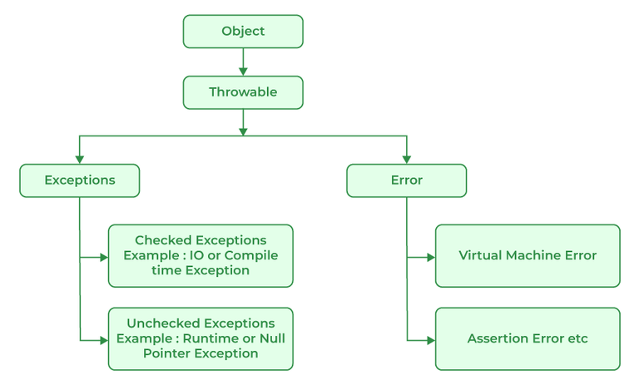
Exception Hierarchy

Slide 12
Difference between Error and Exception
Error: An Error indicates a serious problem that a reasonable application should not try to catch.
Exception: Exception indicates conditions that a reasonable application might try to catch.

Slide 13
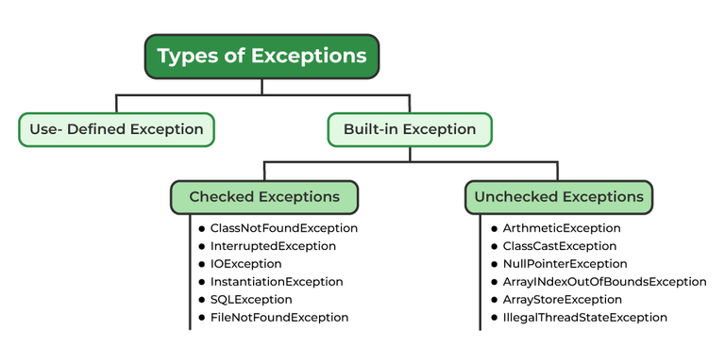
Types of Exceptions

Slide 14
Exceptions can be categorized in two ways:
Built-in Exceptions
Checked Exception
Unchecked Exception
2. User-Defined Exceptions

Slide 15
1. Built-in Exceptions
Built-in exceptions are the exceptions that are available in Java libraries. These exceptions are suitable to explain certain error situations.
Checked Exceptions: Checked exceptions are called compile-time exceptions because these exceptions are checked at compile-time by the compiler.

Slide 16
Unchecked Exceptions:
The unchecked exceptions are just opposite to the checked exceptions.
The compiler will not check these exceptions at compile time.
In simple words, if a program throws an unchecked exception, and even if we didn’t handle or declare it, the program would not give a compilation error.

Slide 17
2. User-Defined Exceptions:
Sometimes, the built-in exceptions in Java are not able to describe a certain situation. In such cases, users can also create exceptions, which are called ‘user-defined Exceptions’.

Slide 18
The advantages of Exception Handling in Java are as follows:
Provision to Complete Program Execution
Easy Identification of Program Code and Error-Handling Code
Propagation of Errors
Meaningful Error Reporting
Identifying Error Types

